Slide 1
Operating Systems: Principles and Practice
Tom Anderson

Slide 2
Main Points (for today)
Operating system definition
Software to manage a computer’s resources for its users and applications
OS challenges
Reliability, security, responsiveness, portability, …
OS history
How are OS X, Windows 8, and Linux related?

Slide 3
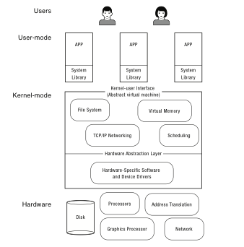
What is an operating system?
Software to manage a computer’s resources for its users and applications

Slide 4
Operating System Roles
Referee:
Resource allocation among users, applications
Isolation of different users, applications from each other
Communication between users, applications
Illusionist
Each application appears to have the entire machine to itself
Infinite number of processors, (near) infinite amount of memory, reliable storage, reliable network transport
Glue
Libraries, user interface widgets, …

Slide 5
Example: File Systems
Referee
Prevent users from accessing each other’s files without permission
Even after a file is deleting and its space re-used
Illusionist
Files can grow (nearly) arbitrarily large
Files persist even when the machine crashes in the middle of a save
Glue
Named directories, printf, …

Slide 6
Question
How should an operating system allocate processing time between competing uses?
Give the CPU to the first to arrive?
To the one that needs the least resources to complete? To the one that needs the most resources?

Slide 7
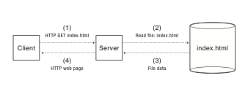
Example: web service
How does the server manage many simultaneous client requests?
How do we keep the client safe from spyware embedded in scripts on a web site?
How do make updates to the web site so that clients always see a consistent view?

Slide 8
OS Challenges
Reliability
Does the system do what it was designed to do?
Availability
What portion of the time is the system working?
Mean Time To Failure (MTTF), Mean Time to Repair
Security
Can the system be compromised by an attacker?
Privacy
Data is accessible only to authorized users

Slide 9
OS Challenges
Portability
For programs:
Application programming interface (API)
Abstract virtual machine (AVM)
For the operating system
Hardware abstraction layer

Slide 10
OS Challenges
Performance
Latency/response time
How long does an operation take to complete?
Throughput
How many operations can be done per unit of time?
Overhead
How much extra work is done by the OS?
Fairness
How equal is the performance received by different users?
Predictability
How consistent is the performance over time?

Slide 11
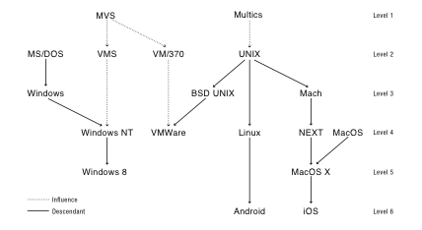
OS History

Slide 12
Early Operating Systems: Computers Very Expensive
One application at a time
Had complete control of hardware
OS was runtime library
Users would stand in line to use the computer
Batch systems
Keep CPU busy by having a queue of jobs
OS would load next job while current one runs
Users would submit jobs, and wait, and wait, and

Slide 13
Time-Sharing Operating Systems: Computers and People Expensive
Multiple users on computer at same time
Multiprogramming: run multiple programs at same time
Interactive performance: try to complete everyone’s tasks quickly
As computers became cheaper, more important to optimize for user time, not computer time

Slide 14
Today’s Operating Systems: Computers Cheap
Smartphones
Embedded systems
Laptops
Tablets
Virtual machines
Data center servers

Slide 15
Tomorrow’s Operating Systems
Giant-scale data centers
Increasing numbers of processors per computer
Increasing numbers of computers per user
Very large scale storage

